Slide 1

IoT 스타트업
컴퓨터공학부 2013-11402 박준완

Slide 2
About AdhereTech
Founded 2011
New York, NY
Makes smart pill bottles
Funded over $2.3 million
Deals with major pharmacies

Slide 3
Prescription adherence
33~69% of hospital admissions
Cost $300 billion / year
125000 deaths / year
Benefits every party in healthcare

Slide 4
Business model
Sponsored by pharma companies
Provides smart pill bottles for free
Also provides live healthcare

Slide 5
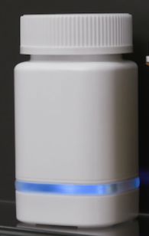
Product
Sensors
Cellular network – no setup
Intervention
Live care
Online dashboard
Free

Slide 6
Effect
Adherence 20%
Duration of therapy 30%
Fill rate 10%
Satisfaction 4.7/5

Slide 7


